Slide 1

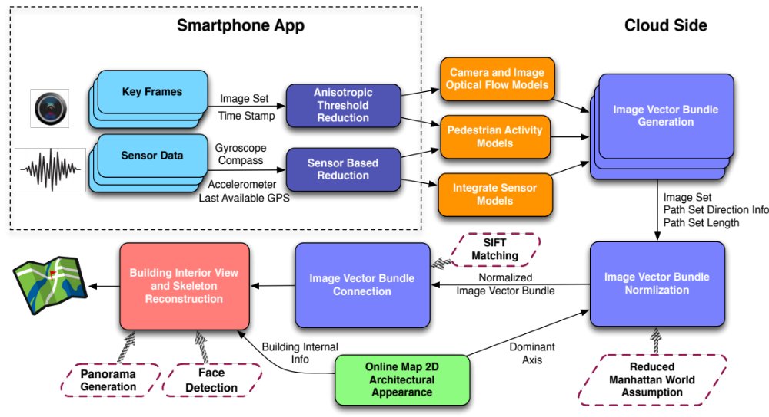
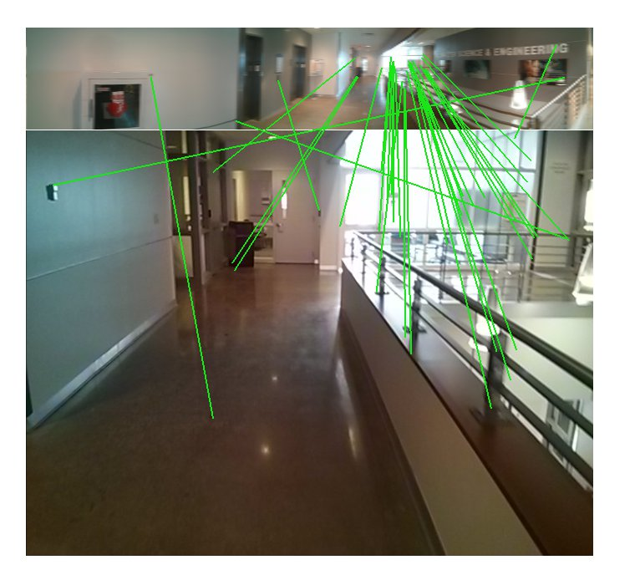
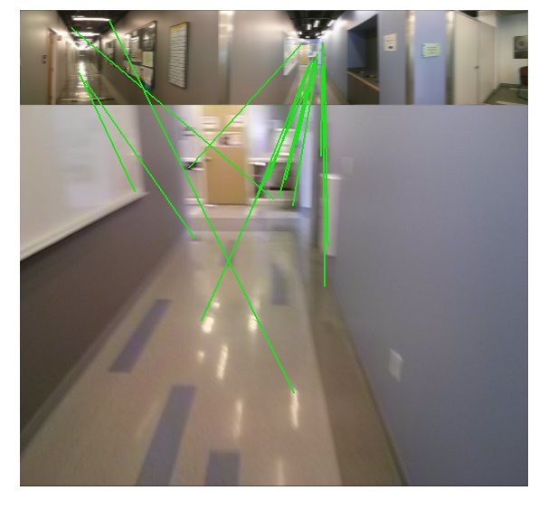
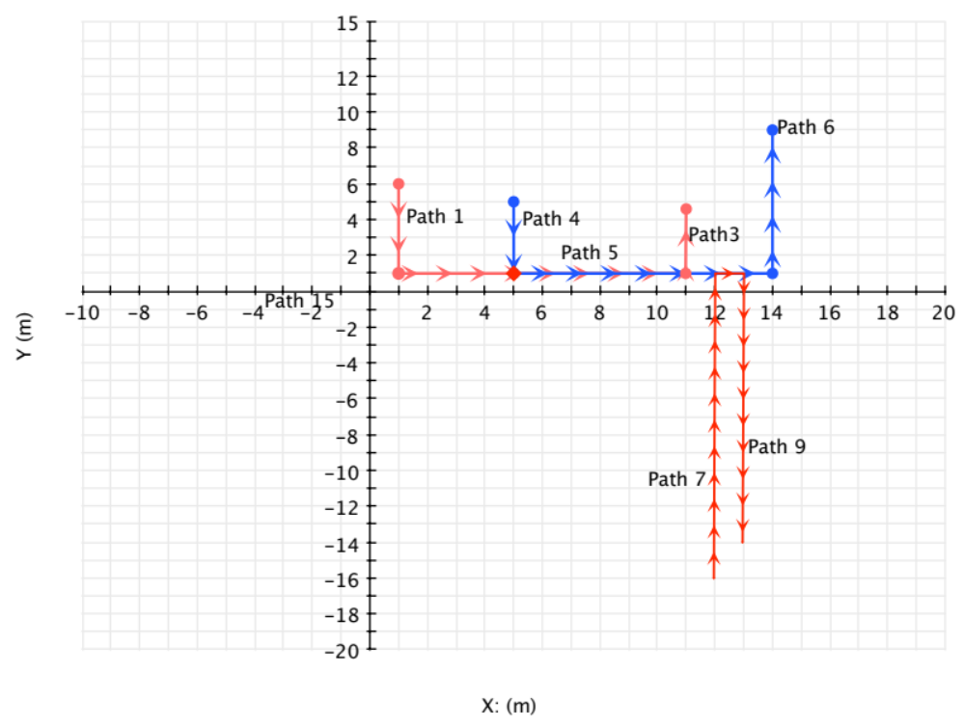
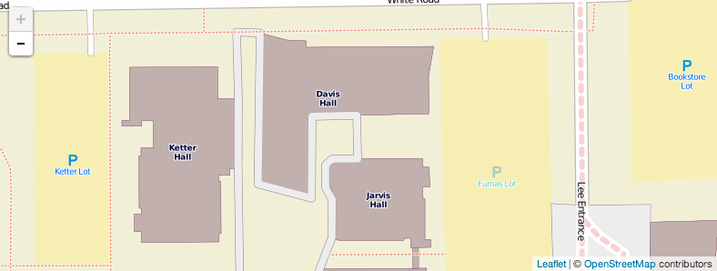
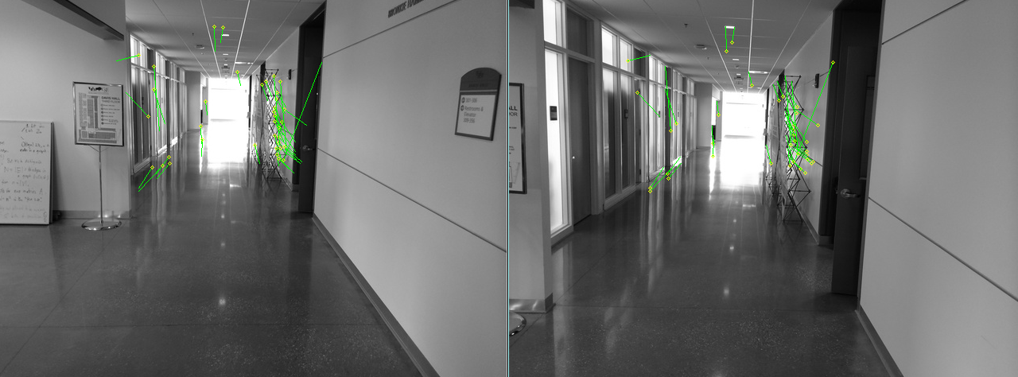
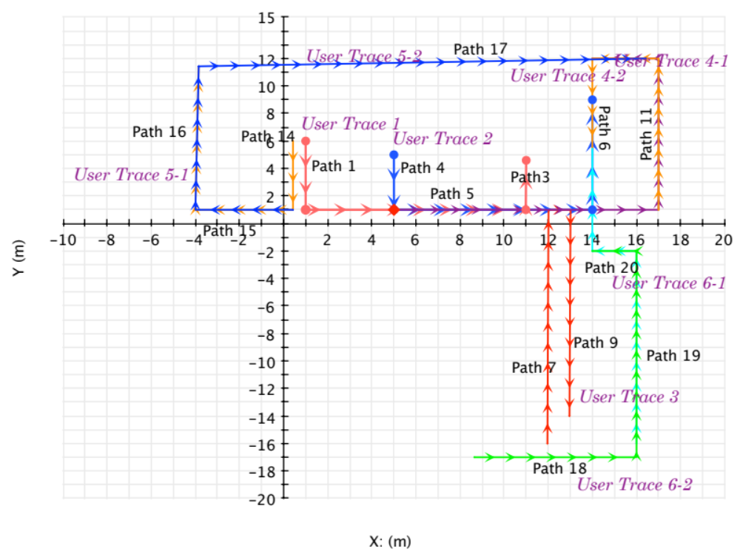
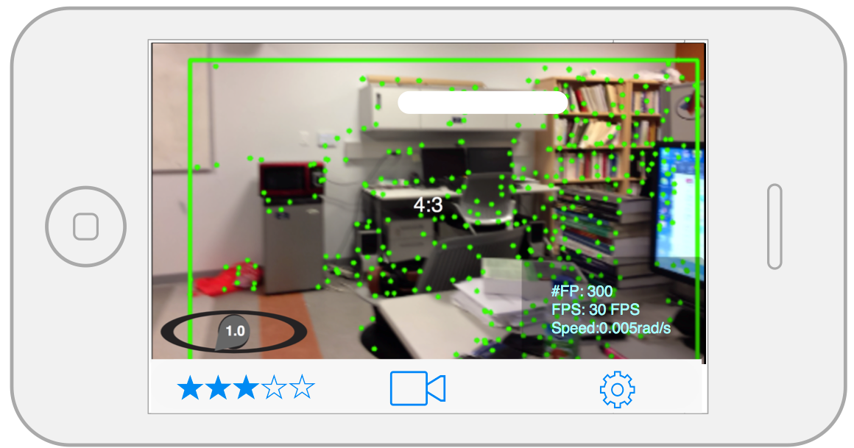
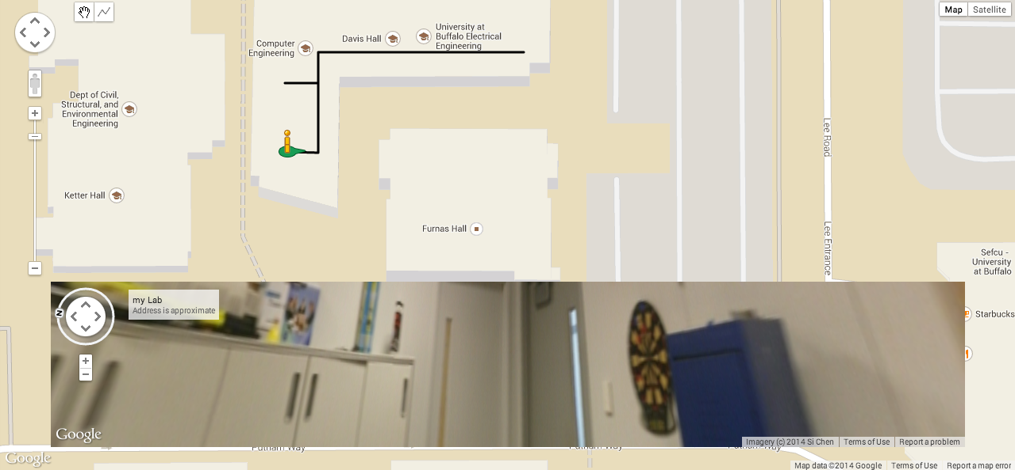
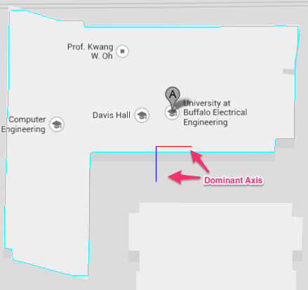
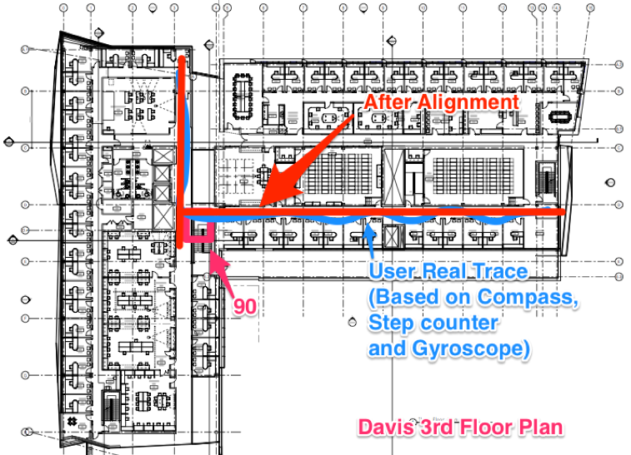


Ubiquitous Security & PrivaCy Research Laboratory (UbiSeC)
The Power of IndoorCrowd: Crowdsourcing Building Interior View
and Skeleton Reconstruction
Department of Computer Science and Engineering
Si Chen, Muyuan Li, Kui Ren
University at Buffalo The State University of New York
Department of Computer Science and Engineering, University at Buffalo, State University of New York, Buffalo, NY 14260, USA
Abstract
System Architecture
Image Vector Bundle (IVB) Connection
Crowdsourcing is a potential enabling technology to revolutionize large-scale pervasive sensing in an extremely cost-effective manner.It provides an unprecedented way of collecting data from the physical world, particularly through the use of modern smartphones which equipped with high-resolution cameras and various micro-electrical sensors. In this work, we address a critical task of reconstruct indoor building interior view and skeleton from crowd-sourced data. We propose, design, and implement IndoorCrowd, a smartphone empowered crowdsourcing system for large-scale indoor scene reconstruction. IndoorCrowd fills a gap in current indoor scene reconstruction systems by leveraging crowdsourcing to collect large-scale data. To overcome data quality challenges posed by untrained individual contributors, we propose an efficient scheme to enhance the captured image quality for building interior reconstruction at mobile clients. At the cloud side, we deploy an automated image vector bundle (IVB) processing pipeline, which generates building interior views from images and sensor data. Moreover, we provide an estimated building skeleton for each building which shows the relative position for each image. We present that our system can easily integrate with other existing online map system, such as OpenStreetMap (OSM) and Google Map.
Figure 6. (a) (b)
Figure 6. (a) (b) shows the matches between SIFT features from two images
Research Motivation
Figure 6. (c)
Unlike outdoor environment, reconstruct building interior are much more difficult. This is due to the reason that indoor environment contains a lot of private areas that cannot be accessed by the public. What’s more, no accurate GPS signal available inside the building, and thereby, it is difficult to acquire the geographic location for each image in indoor environment. Hence, existing outdoor ‘street-view’ reconstruction techniques cannot be directly applied to indoor environment.
Figure 3.
Figure 3. Shows the architecture of our building interior view and skeleton reconstruction system
Figure 6. (c) shows the matching result of three long image vector bundles
Image Vector Bundle (IVB) Generation
Figure 6. (d)
Figure 1.
Figure 6. (d) shows the matching result of six long image vector bundles
Figure 1. Shows there are no building interior view and skeleton information available for UB north campus buildings on OpenStreetMap (OSM).
Building Interior View and Skeleton Reconstruction
Mobile Application Design
5 μm
Figure 4. (a) (b)
Figure 4. (a) (b) shows the dynamics of a feature vector p over two consecutive frames
Image Vector Bundle (IVB) Normalization
Figure 7.
Figure 7. shows the output building interior view and building skeleton we use Google Map API to elaborate the final result
Figure 2.
Acknowledgement
Figure 2. Shows the smartphone app graphic user interface (GUI).
Our research is now supported by Microsoft Research
Windows Azure Research Grant
We proposed a mobile application on both Android and iOS system to let the crowd contribute their data. To overcome data quality challenges posed by untrained individual contributors, we propose an efficient scheme to enhance the captured image quality for building interior reconstruction at mobile clients.
Figure 5. (a) (b)
Figure 5. (a) shows the output dominant axis of Davis Hall (b) shows how to align user trajectory to dominant axis

